Slide 1
Scheduling Sleep:
A Clear Mind, A Combat Edge
Nita Lewis Shattuck, Ph.D.
Operations Research Department

Slide 2
Pretending to be superhuman is very dangerous. In a well-led military, the self-maintenance of the commander, the interests of his or her country, and the good of the troops are incommensurable only when the enemy succeeds in making them so. It is time to critically reexamine our love affair with stoic self-denial, starting with the service academies. If an adversary can turn our commanders into sleepwalking zombies, from a moral point of view the adversary has done nothing fundamentally different than destroying supplies of food, water, or ammunition. Such could be the outcome, despite our best efforts to counter it. But we must stop doing it to ourselves and handing the enemy a dangerous and unearned advantage.
-- Jonathan Shay, 1998

Slide 3
Overview
Normal sleep
Human performance is affected by
  Circadian variability
  Reduced/restricted sleep
Sleep in adolescents and young adults
Sleep and the military culture
Tips for Healthy Sleep

Slide 4
What is Sleep?
Sleep is an ACTIVE process
Probably all animals sleep (various lengths)
May be the strongest, most insistent drive
Still not known exactly why we sleep
  Restorative function?
  Adaptive function?

Slide 5
Examples of Total Daily Sleep in Mammals
Mammal Total Daily Sleep Time (hours)
Giraffe 1.9
Roe deer 3.09
Asiatic elephant 3.1
Pilot whale 5.3
Man 8.0
Baboon 9.4
Domestic cat 12.5
Laboratory rat 13.0
Lion 13.5
Eastern chipmunk 15.8
Little brown bat 19.9
Source:http://www.sleephomepages.org/sleepsyllabus

Slide 6
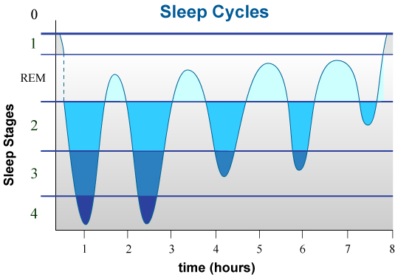
Source: N.L. Miller, 2004

Slide 7
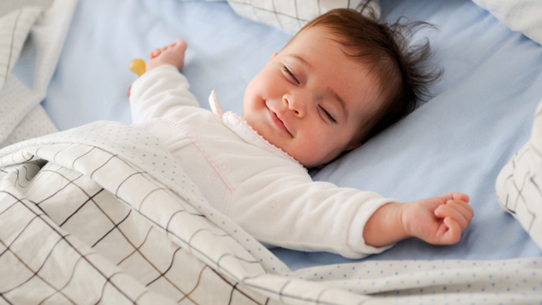
Benefits of Sleep
Better sleep is linked to improved:
  Memory
  Creativity
  Productivity
  Concentration
  Happiness
  Optimism
  Frustration tolerance
Courtesy of Dr. Jennifer Murphy

Slide 8
The Straight Skinny about SLEEP
Most individuals need 7 to 8 of sleep at night to function optimally for maximum alertness.
The human body cannot be trained to need less sleep.
Sleep loss:
  reduces the ability to control one’s impulses, delay gratification, and make mature and sound moral decisions;
  hinders one’s ability to accurately interpret the emotions of others and identify what one is feeling—specifically, the ability to identify angry and happy facial expressions;
  lowers the ability to interact effectively with those around you and to communicate effectively;
  decreases one’s ability to understand where others are coming from and reduces one’s ability to maintain good relationships.
Source:
DOD Human Performance Resource Center
HPRC-online.org
“The Impact of Sleep Loss on Total Fitness”

Slide 9
Scientific Findings
Decision-making under uncertainty may be particularly vulnerable to sleep loss and is more pronounced with increased age. (J. Sleep Research, 2006)
Moral judgment is altered by sleep deprivation. (Sleep, March 2007)
Health consequences: weight gain (ghrelin and leptin levels), heart and kidney disease, immune response are all affected by sleep.

Slide 10
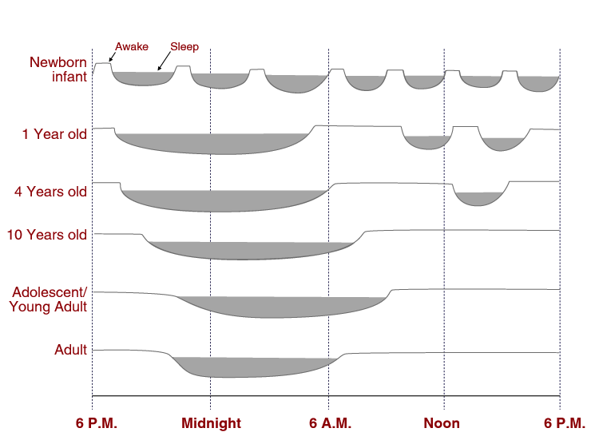
Sleep Patterns over the Life Span
(Source: NL Miller, 2003)

Slide 11
Circadian Rhythms

Slide 12
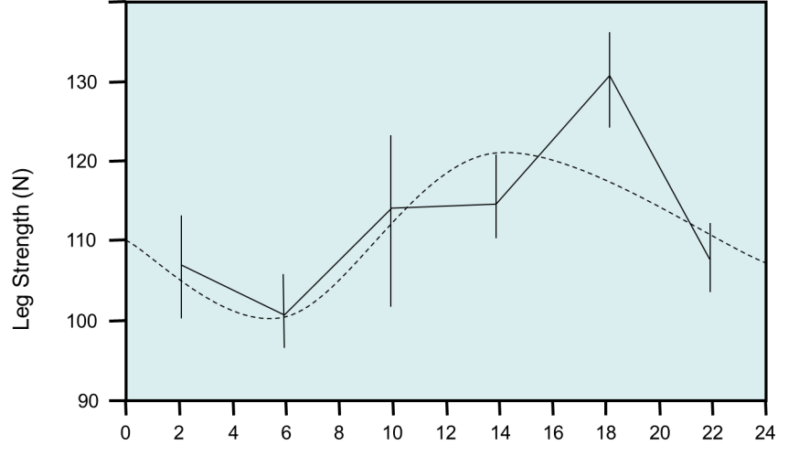
Time of Day Effects on Leg Strength Measures
Time of Day (Hours)
Peak occurred at 1653 Hrs.
Peak to trough differences were approximately 21%.
Source: Coldwells, Atkinson & Reilly (1994)

Slide 13
Melatonin in Adults
24:00
midnight
21:00
Melatonin
secretion starts
02:00
Deepest sleep
04:00
Lowest body temp
19:00
Highest body temp
Highest BP 18:30
18:00
06:00
17:00
Greatest CV efficiency
& muscle strength
06:45
Sharpest BP rise
07:30
Melatonin
secretion stops
15:30
Fastest reaction time
14:30
Best coordination
10:00
Highest
alertness
12:00
noon

Slide 14
Melatonin in Adolescents and Young Adults
23:00
Melatonin
secretion starts
24:00
midnight
02:00
Deepest sleep
04:00
Lowest body temp
19:00
Highest body temp
Highest BP 18:30
18:00
06:00
17:00
Greatest CV efficiency
& muscle strength
06:45
Sharpest BP rise
15:30
Fastest reaction time
09:00
Melatonin
secretion stops
14:30
Best coordination
10:00
Highest
alertness
12:00
noon

Slide 15
What happens when I go without sleep?

Slide 16
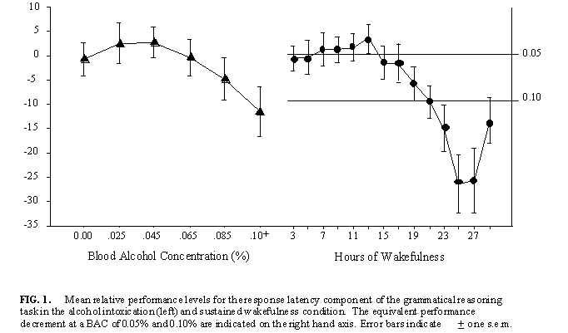
Reasoning Performance vs. BAC and Hours Awake
“Skipper, I’m good to go, I’m just a little tired…”
“Skipper, I’m good to go, I’m just a little drunk…”
14 hours
<19 hours
Sources: Figures: Dawson and Reid, 1997; Captions: Couch, 2016
Notes:
This one’s easy:
What would you think if one of your sailors told you this:
*CLICK*
“Captain, I’m good to go… just a little tired.” Okay, we hear that all the time. And we probably take note of it. A lot of us would tap the brakes, maybe ask a few ORM questions. Maybe ask, “Are you sure you’re okay?” but the sailor just told you he is, so is he really going to change his report now? Maybe, but probably not. And then what? We’re probably going to press on, because that’s what we do. That’s our culture – we’ve got to get the job done. We suck it up, we’ll catch up on our sleep later.
*CLICK*
Captain, I’m good to go. Just a little drunk.” He didn’t say “hung-over,” he didn’t say “buzzed” (would that matter?). No, he’s “A little drunk.” And what’s a little drunk? Would you care? Or would you be pretty much ready to send him to a fit-for-duty screening, get him off the watchbill and start considering NJP proceedings because he even bothered to show up? In any event, are you going to let him stand the watch. Nope. Because we all know that’s unacceptable. We can’t drink and drive, and we certainly can’t drink a stand duty. It’s embedded in our collective consciousness.
Why? Because we all know that performance is impaired when drunk? What performance? A bit of everything: decision making, inhibitions, physical motor skills, reaction times. And many more. And all of them add up to: a person cannot satisfactorily perform basic, simple tasks when drunk beyond a certain point. What’s that point? Legally, we have a couple of thresholds: .05, .08., and we’re all familiar with what those mean – impairment to the point of legal intoxication, resulting in an inability to pass basic sobriety tests.
Now have a look at a little data, captured in this chart:
*CLICK*
Here is a chart capturing cognitive performance data for a large number of individuals on an evaluation after drinking alcohol. I don’t need to say much about it. We know their blood alcohol content increases with time, and we know their cognitive performance decreases.
But now look at this!
Here’s what happens as you go through your day and rack up fatigue from the duration since your last restorative sleep cycle. The charts have a very similar curve. That’s probably not surprising either, because I know you’re educated people. But take a closer look at the bottom of the chart.
*CLICK*
Never mind, let me just highlight that for you. At only 14 hours awake, your sleepy sailor is going to have the mental capability of a person strongly buzzed at a BAC of .05. Think of that: a sailor that woke up at 0600 for a pretty typical day, is already performing like she’s border-line drunk by 2000.
And less than 5 hours later, she’s down in the range where she’s too incapacitated to legally drive – if it were caused by alcohol.
Does it matter? If your sailor falls down a trunk, or fails a PMS check, or performs an improper tag-out procedure… does it matter whether it was the result of sleepiness or drunkenness? The end result is the same, the mishap category will be the same… the loss of life will be the same. Injuries and equipment damage don’t care what caused them – they happen all the same.

Slide 17
WRAIR Restricted Sleep Study:
PVT Adaptation to Chronic Sleep Restriction
Baseline
7 Day Restricted Sleep
Recovery
110
95
9 Hr
Mean Speed on Psychomotor Vigilance Task
80
(as a % of Baseline)
7 Hr
5 Hr
65
3 Hr
SAFTE/FAST
2
0.94
R
=
50
0
T1
T2
B
1
2
3
4
5
6
7
R1
R2
R3
Day
(Belenky et al., 2003)

Slide 18
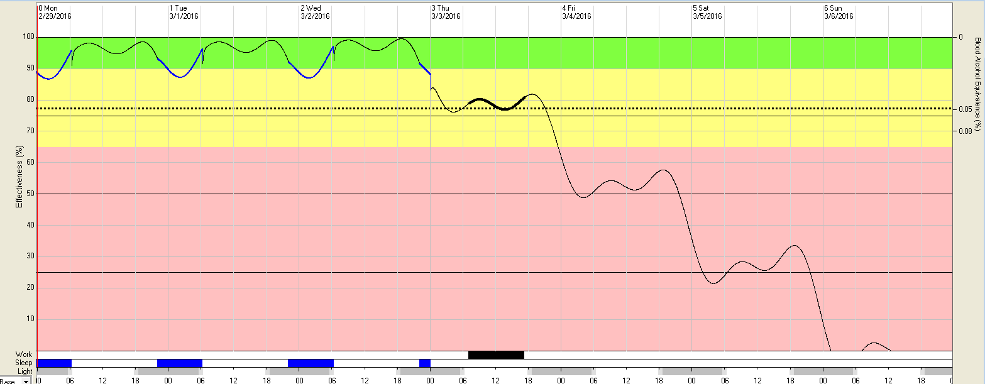
Fatigue Avoidance Scheduling Tool (FAST)
Drop in performance
Early AM dip in performance
Blood Alcohol Equivalent Scale
24 hour period
Afternoon dips in performance
Normal sleep periods
Reduced sleep period

Slide 19
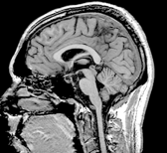
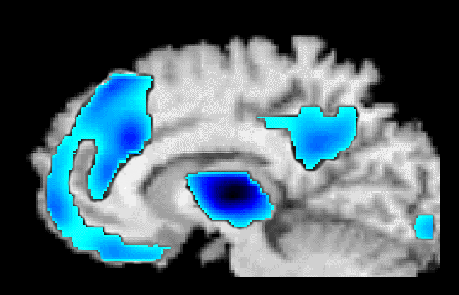
Sleep Loss Degrades
Brain Energy Metabolism
19
These areas control:
Alertness
Vigilance
Situational awareness
Adaptability
Mental agility
Judgment
Initiative
Anticipation
Planning
Multi-modal
Association Cortex
Medial Parietal
Cortex
Prefrontal
Cortex
Occipital
Cortex
Thalamus
Slide courtesy N. Wesensten, PhD; WRAIR
Notes:
19
Thomas at WRAIR sleep deprived test subjects, then got PET scans of their brains. Overall, the brains showed about 7% lower metabolic activity, with certain areas even lower, depicted in blue. These areas are the prefrontal cortex, multimodal association cortex, the medial parietal cortex, the occipital cortex, and the thalamus. These brain areas are associated with:
Ability to maintain wakefulness in a boring or non-stimulating environment:
Alertness
Vigilance
Higher order mental operations:
Situational / battlefield awareness
Adaptability, mental agility, judgment
Initiative
Anticipation, planning.
During recovery sleep, the frontal areas remained deactivated during REM and deep sleep, and recovered on awakening.

Slide 20
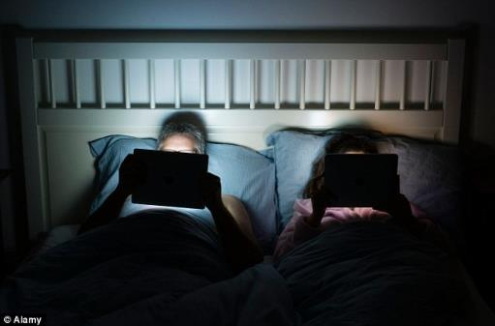
Sleep in the digital age
90% of Americans use an electronic device within the hour before bed time
Notification on a device = dopamine loop and variable reward
Text, web-surfing before bed associated with higher stress, less sleep
Blue light affects melatonin, normal circadian rhythm
Courtesy of Dr. Jennifer Murphy

Slide 21
RAND Europe Report, 2016

Slide 22
RAND Europe Report, 2016
Key Findings
The US sustains by far the highest economic losses (up to $411 billion a year) due to the size of its economy, followed by Japan (up to $138 billion a year).
On an annual basis, the US loses an equivalent of about 1.23 million working days due to insufficient sleep.
Sleep deprivation is linked to a higher mortality risk.

Slide 23
Individual Costs of Insufficient Sleep
An individual who sleeps less than six hours per night on average has a 13% higher mortality risk than a person sleeping between seven and nine hours.
For “in-betweeners” who get six to seven hours of sleep, the mortality risk is still 7% higher for all causes of death, including car accidents, strokes, cancer and cardiovascular disease.
Source: RAND Europe report 2016
http://www.rand.org/pubs/research_reports/RR1791.html

Slide 24
Epworth Sleepiness Scale

Slide 25
Two Questions
Have you ever been a shiftworker?
(that is, worked hours outside 8 to 5 routine)
How many years did you do shiftwork?

Slide 26
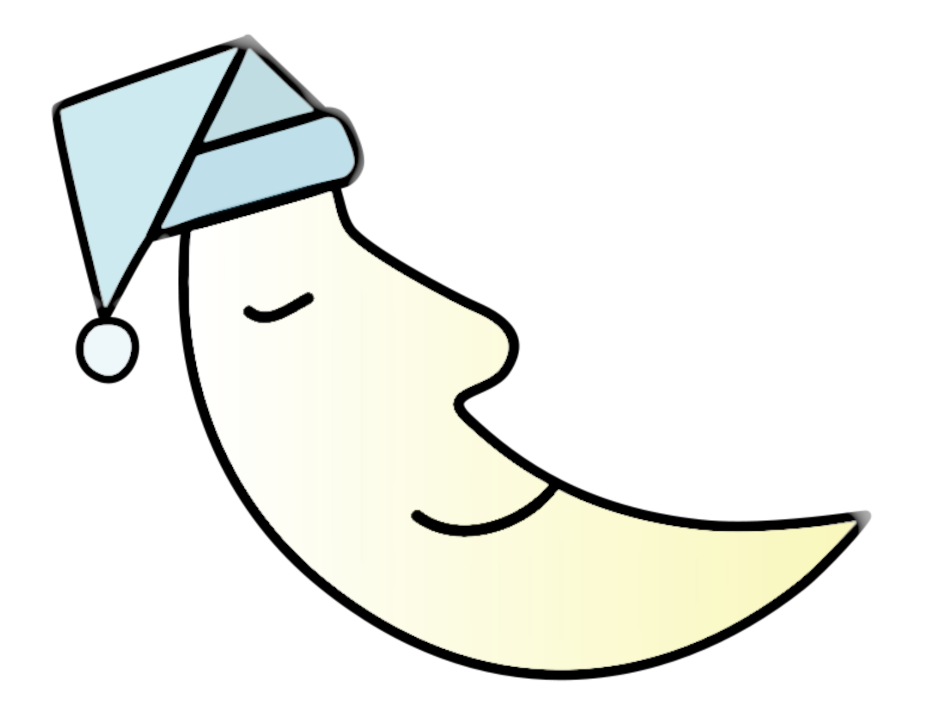
Shiftwork Implications for Organizations
Higher rates of workplace accidents in the afternoon and night shifts.
Working shifts longer than 8 hours results in an increased risk of accidents (2 times greater at 12 vs. 8 hour shifts)
23
Notes:
Homo sapiens is a diurnal species, hard-wired to spend
much of the night in sleep (Moore, 1997). Having to work at
night, and thus sleep during the day, is essentially an
unnatural act, often requiring a circadian phase shift equivalent
in magnitude, for example, to that of a flight from
Moscow to Chicago (Monk, 2000). Moreover, even permanent
night workers invariably revert to a diurnal orientation
during their days off and are thus, in practice, experiencing
repeated circadian phase shifts on a weekly basis, much as
is the case for rotating shiftworkers (Knauth and Hornberger,
2003). Not surprisingly, while these profound circadian phase
shifts are happening to the individual (perhaps repeatedly for
several decades), sleep is often severely impaired. There are
many empirical studies documenting the fact that shiftworkers
sleep more poorly than day workers during their working
lives, confirming the conventional wisdom of the shiftworkers
themselves (Akerstedt, 2005; Drake et al., 2004). However,
there are also data that suggest that the point can be
overstated (Akerstedt et al., 2008).

Slide 27
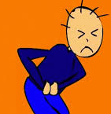

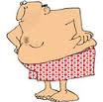

Shiftwork in the civilian population
Associated with increased rate of disorders in:
Gastrointestinal
Cardiovascular
Metabolic (diabetes, weight gain)
Obstetric complications

Slide 28


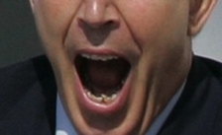
Shiftwork Findings
Linked to higher rates of colon and breast cancer in women and prostate cancer in men – suspected carcinogen (World Health Organization, 2007)
Shiftworkers (especially night shiftworkers) experience greater fatigue than day workers. Prolonged exposure to shiftwork degrades physical & psychological well-being (Tucker & Folkard, 2012).
Critical decision-making is impaired following night shiftwork and prolonged wakefulness (Horne, 2012).
23
Notes:
Homo sapiens is a diurnal species, hard-wired to spend
much of the night in sleep (Moore, 1997). Having to work at
night, and thus sleep during the day, is essentially an
unnatural act, often requiring a circadian phase shift equivalent
in magnitude, for example, to that of a flight from
Moscow to Chicago (Monk, 2000). Moreover, even permanent
night workers invariably revert to a diurnal orientation
during their days off and are thus, in practice, experiencing
repeated circadian phase shifts on a weekly basis, much as
is the case for rotating shiftworkers (Knauth and Hornberger,
2003). Not surprisingly, while these profound circadian phase
shifts are happening to the individual (perhaps repeatedly for
several decades), sleep is often severely impaired. There are
many empirical studies documenting the fact that shiftworkers
sleep more poorly than day workers during their working
lives, confirming the conventional wisdom of the shiftworkers
themselves (Akerstedt, 2005; Drake et al., 2004). However,
there are also data that suggest that the point can be
overstated (Akerstedt et al., 2008).

Slide 29
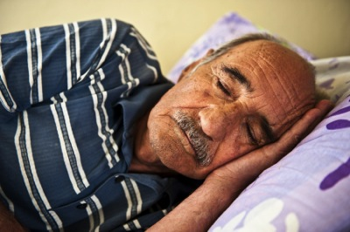
Shiftwork and Sleep in Retirees
Shiftwork exposure has a dose-response effect on retirees’ quality and quantity of sleep, even years after their retirement.
Retirees report worse sleep quality if they were ever shiftworkers
  Telephone survey of >1000 retirees showed elevated PSQI scores of former shiftworkers (Monk et al., 2013 a)
Lab confirmation: Retirees have poorer sleep
  Laboratory study of retirees found poorer sleep in former shiftworkers compared to non-shiftworkers -- suggesting potential “circadian scarring” (Monk et al., 2013 b)
24

Slide 30
The Big Gray Elephant
“Fatigue is so prevalent and such a part of our culture that we scarcely see or recognize it. It’s the big gray elephant we muscle out of the cockpit when we fly, step around when we enter the bridge, and push aside when we peer into the periscope.”
CAPT Nick Davenport
Command Flight Surgeon
Naval Safety Center

Slide 31
Sleep and the Warfighter
US Army Surgeon General’s Mental Health Advisory Team (MHAT IV-VII) found:
Number one concern among deployed Warfighters continues to be not getting enough sleep (2006-2009).
2010: Significant increase in percentage of Marines who report high or very high concern about not getting enough sleep (2010 vs 2006-7)
Warfighters who have experienced combat have more trouble sleeping—both during and after deployment—than those who have not deployed (Seelig et al., 2010)
Source: Office of the Surgeon General, US Army Medical Command; Office of the Command Surgeon, HQ USCENTCOM; and Office of the Command Surgeon US Forces Afghanistan MHAT Reports IV, V, VI, VII 2006-2010;
Seelig AD, Jacobson IG, Smith B, et al. 2010.

Slide 32
NPS Sleep Studies 2002-2016
Note 1: Blue bars indicate actigraphic sleep, gold bars are self-reported sleep
Note 2: Number centered on each bar refers to study sample size
Note 3: Horizontal lines indicate one standard deviation
Last update: Oct 2016

Slide 33
NPS Sleep Studies 2002-2016
Note 1: Blue bars indicate actigraphic sleep, gold bars are self-reported sleep
Note 2: Number centered on each bar refers to study sample size
Note 3: Horizontal lines indicate one standard deviation
Last update: Oct 2016

Slide 34
Sleep debt begins on Day One of military service…
A Comparison of Sleep between Brown University Students and Cadets at USMA, West Point
Note: Brown University data were collected on the Class of 1992 (Fall 1988 – Spring 1990 using self-report. USMA data were collected using actigraphy on the Class of 2007 Fall 2003 – Spring 2005 (Miller, Shattuck, & Matsangas, 2010).

Slide 35
…and continues throughout their careers
Even non-deployed military sleep less than civilians
Hrs. of Sleep
18

Slide 36
On average, how many hours did you sleep per night in the past 30 days?
Sleep Question from DEOCS (2013)
Sleep per night | Frequency | Percent
3 hours or less | 2,401 | 2
4 hours | 8,952 | 8
5 hours | 21,386 | 20
6 hours | 35,521 | 33
7 hours | 25,263 | 24
8 hours | 12,264 | 11
9 hours | 815 | 1
10 or more hours | 992 | 1
Total | 107,594 | 100
63% get 6 hours or less sleep per night
Defense Equal Opportunity Climate Survey (DEOCS)
Slide courtesy of Geoff Patrissi, NPRST

Slide 37
Scientific Studies in Military Training and Education

Slide 38
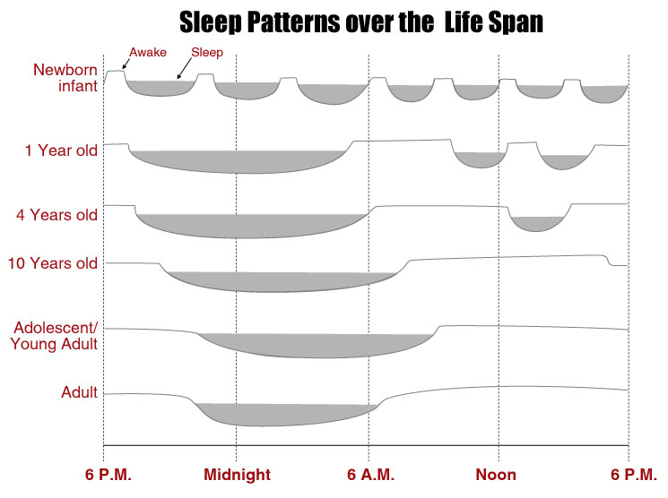
Adolescents & young adults have a distinct phase-delayed sleep pattern

Slide 39
Insufficient sleep has known negative effects on training & education
Multiple nights of less than 8 hours sleep result in sleep debt & fatigue, the consequences of which include:
  Decreased vigilance, adverse mood changes, perceptual & cognitive decrements (Krueger, 1990; Belenky et al., 2003; van Dongen et al., 2003)
  Impaired judgment & increased risk taking (Killgore, Balkin, & Wesensten, 2006)
  Decreased marksmanship (Tharion, Shunkitt-Hale, & Lieberman, 2003; McLellan et al., 2005)
Ability of individuals to learn & retain information is impaired by sleep deprivation
  Role of sleep in memory consolidation and latent learning (Fenn et al., 2003; Gais et al., 2000; Stickgold et al., 2000; Walker et al., 2003)
  Learning curves drop for adolescents with 4–6 vs. 8 hrs sleep (Graham, 2000)
  Positive correlation between academic performance & daily sleep (Trickel et al., 2000; Killgore et al., 2008)

Slide 40
Potential Benefits of Extending and Improving Sleep in Training
Improved test scores
Better retention of knowledge
Fewer sick calls
Decrease in discipline problems
Decrease in depression
Improved morale
Lower attrition

Slide 41
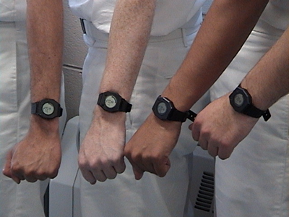
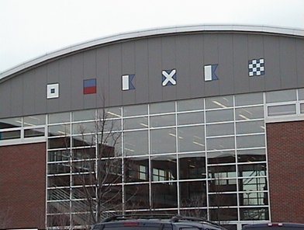
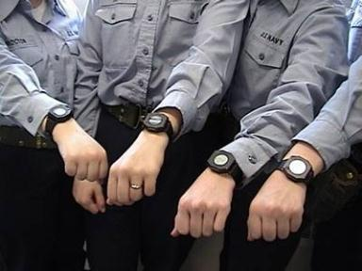
Great Lakes USN Recruit Studies: 2002-2004
Recruit sleep at Boot Camp was increased from 6 to 8 hrs/night (in line with other service basic training and with USN Recruit training 20 years ago.)
Initial study quantified the sleep received by Recruits; follow-on study examined changes in test scores following the increase in sleep.

Slide 42
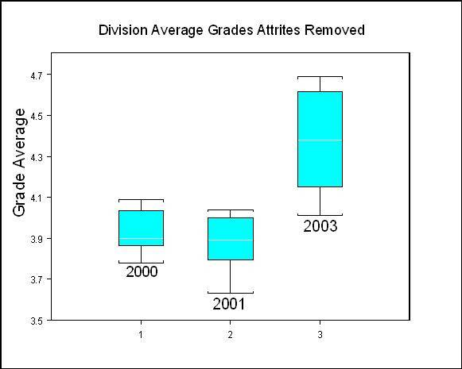
USN Recruits Standardized Test Scores with 6 vs. 8 hrs Sleep/Night
8 hr
6 hr
6 hr
NPS thesis by LCDR Charles Andrews, Sept 2004
Notes:
It is important to note that additional changes were made to the Recruit Training program at this same time, including new dormitories, changes in the curriculum to encourage and educate recruits on the importance of sleep, changes in the kind of boots they were issued and handwashing policy.

Slide 43
USMA West Point Cadet Sleep by Gender and Academic Year
2017 Request by USMA Commandant to repeat study to determine how USMA Cadets are doing. Athletic Department interested in Corps Squad athletes.

Slide 44
FT Leonard Wood US Army Basic Combat Training Study
Bottom Line Up Front:
Accommodating adolescent sleep patterns makes a difference
in Soldier health and performance
in the training environment.

Slide 45
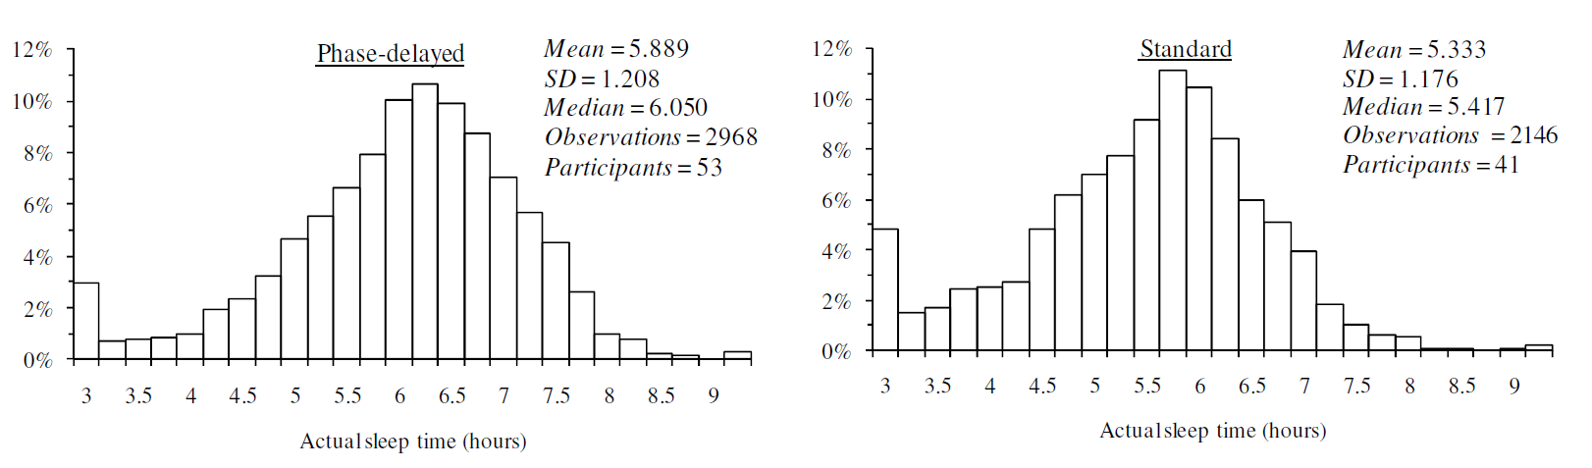
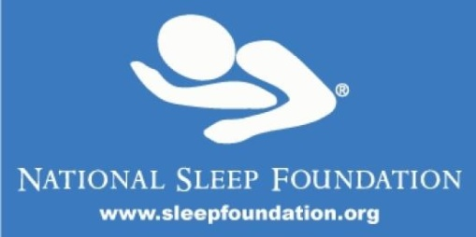
Soldiers on phase-delayed sleep schedule obtained
33 minutes more sleep per night than those on the standard schedule
  B Co followed phase-delayed sleep regimen (2300–0700)
  C Co followed standard BCT sleep regimen (2030–0430)
Compared to Soldiers in the phase-delayed group, Soldiers on the standard sleep schedule were 3.8 times more likely to fall below the National Sleep Foundation’s recommended amount of sleep for adolescents and young adults.

Slide 46
Soldiers on the phase-delayed sleep schedule
  Reported:
      Less anger–hostility & lower total mood disturbance scores early in training; although differences between groups diminished over time
      Greater feelings of vigor than standard sleep group (modest effect size)
Decreased
      Tension–anxiety
      Depression–dejection
      Fatigue–inertia
      Confusion–bewilderment
  Greater improvement in Marksmanship
  Significantly less daytime sleepiness

Slide 47
Common USN Watchbills
Circadian (24 hour)
3-section
Non-Circadian
3-section
4-section
6/6
12/12
4/8 (Fixed)
8/16
3/9
6/18
4-section
5/10
6/12
5/15
Watch schedules
2-section
Day 5 /Night 3
Workday includes duties other than watchstanding.
Other watchbills may be implemented by the command

Slide 48
NIMITZ PVT Results – Reaction Time and Errors
Compared to 5/10, crewmembers on 3/9 were approximately 30% faster
Crewmembers on the 3/9 had 40% to 50% fewer errors (lapses combined with false starts)

Slide 49
Mood Results
Difference in Mood as measured by Profile of Mood State (POMS) Total Score
  5/10: Mood deteriorated during the underway
  3/9: Mood did not change (slight improvement)
p=0.039

Slide 50
Guiding Principles developed for ADM Richardson
Focus on alert and engaged watchstanders.
Learn and understand the effects of good sleep practices.
Use the 24-hour circadian rhythm to set the foundation.
Build a stable daily schedule including the watch bill that maximizes rest opportunities at the same time each day.
One size does not fit all -- consider tradeoffs.
Get supporting analysis on your schedule before you make a final decision.
Fatigue is a Safety Issue and increases Operational Risk.
Sleep is a weapon.
A clear mind is a combat edge.
Notes:
These are the guiding principles for effective implementation of a crew endurance management plan. Adjusting the watch schedule so that all personnel are on a 24-hour day is one of the key elements – although this alone is not enough to not result in a healthier and productive crew. Crew endurance is the result of proactive management of total-ship operations.

Slide 51
Sleep as a Weapon
Sleep is the critical third part of the triad that leads to peak personal readiness to train and fight…
Fatigue has measureable negative effects on readiness, effectiveness and safety… After a day without sleep, human performance drops to dangerously ineffective levels… sleep deprivation… yield[s] the same results in just a few days. The detrimental impacts to our sailors include longer training time, procedural errors, degraded decision making and potentially mission failure.
Adequate sleep… sharpens performance and increases crew endurance… reduces stress, improves productivity and boosts morale. It directly and measurably increases mission effectiveness and combat readiness.
~ VADM Thomas Rowden, COMNAVSURFOR
Warfighting Serial #10
Notes:
Why are we going to discuss endurance, fatigue and sleep? We’ve all been doing this long enough to understand that we’ve got a job to do, and that job doesn’t operate on a set schedule. We’re going to do what we need to do to get the job done, because our commanders expect nothing less from us, so we expect nothing less from ourselves or those that work for us.
So, I present these words from Vice Admiral Rowden, Commander, Naval Surface Forces.
** PAUSE **
Vice Admiral Rowden thinks of sleep as a weapon, so I’d like to take a few minutes to explain why, and how you can use that knowledge to sharpen it.
He also uses the word “measureable” more than once in here, and that’s an important point that I’ll discuss in the next few slides. But here’s the critical take-away right up-front: his idea that fatigue is bad doesn’t come from a general, vague sense that it might hurt performance in some undetermined way. It has been extensively studied, and the data is objectively clear.
The Problem then is that crew endurance and resilience are directly affected by how much we sleep. Fatigue, stress, mental and physical fitness are all interrelated. Fatigue and stress; Fatigue and suicide; Fatigue and mishaps; fatigue and mission failure.
Bottom line: Fatigue has repeatable, tangible and measurable negative effects on readiness, effectiveness, and safety.

Slide 52
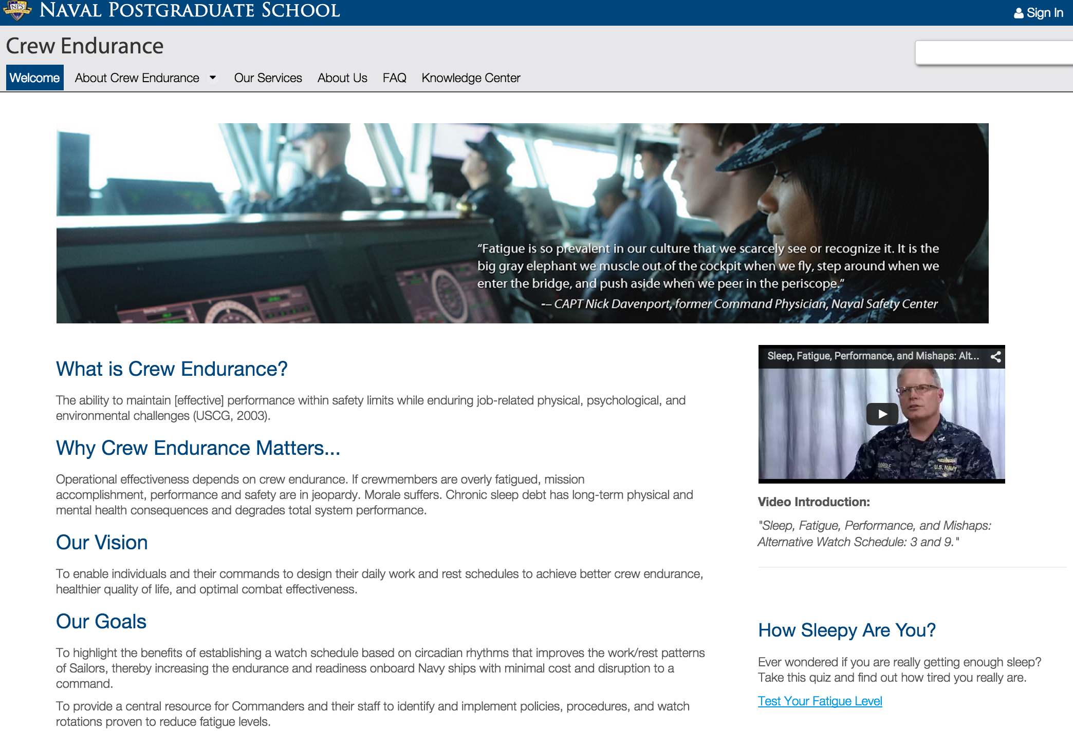
NPS Crew Endurance Website
http://my.nps.edu/web/crewendurance

Slide 53
RAND Europe Report, 2016
Recommendations
To improve sleep outcomes, individuals should: Set consistent wake-up times; limit the use of electronic items before bedtime; and exercise.
Employers should: Recognise the importance of sleep and the employer's role in its promotion; design and build brighter workspaces; combat workplace psychosocial risks; and discourage the extended use of electronic devices.
Public authorities should: Support health professionals in providing sleep-related help; encourage employers to pay attention to sleep issues; and introduce later school starting times.

Slide 54
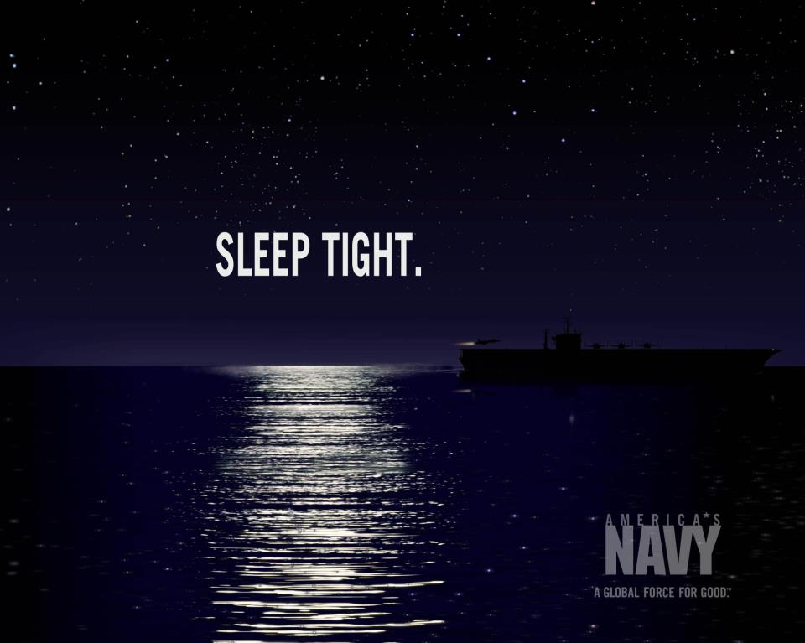
Questions?
Contact information:
Nita Lewis Shattuck, Ph.D.
(831)656-2281
nlshattu@nps.edu
  NPS Crew Endurance Resource Website
https://my.nps.edu/web/crewendurance

Slide 55
Sleep Resources
Some Helpful Sleep-Related Apps:
CBT-I Coach
F-lux (for blocking blue light from computer screens)
CrewAlert Lite
Crew Endurance Resources:
http://my.nps.edu/web/crewendurance
Websites:
The National Sleep Foundation is a nonprofit organization in the USA whose stated objectives are to improve public health and safety by achieving understanding of sleep and sleep disorders, and to support sleep-related education, research, and advocacy. https://sleepfoundation.org/
The Centers for Disease Control's website has training for emergency responders to reduce the risks associated with long work hours. http://www.cdc.gov/niosh/emres/longhourstraining/
The website for the Naval Center for Operational Stress Control is a great resource for managing stress and fatigue levels. http://www.med.navy.mil/sites/nmcsd/nccosc/serviceMembersV2/Pages/default.aspx
The Naval Safety Center offers some great resources on sleep and safety. They have a large number of resources including videos and articles.
The DOD Human Performance Resource Center website has great resources on Total Force Fitness. http://hprc-online.org/ One of their links is the Performance Triad initiative started by the Department of Defense and in trial phase at various military installations. http://hprc-online.org/total-force-fitness/performance-triad
The Navy and Marine Corps Public Health Center website has some valuable resources for managing sleep and fatigue. http://www.med.navy.mil/sites/nmcphc/health-promotion/psychological-emotional-wellbeing/relax-relax/pages/index.html

Slide 56
10 Sleep Tips
Healthy sleep habits can make a big difference in your quality of life. Having healthy sleep habits is often referred to as having good “sleep hygiene”.
Try to keep the following sleep practices on a consistent basis: Stick to a sleep schedule of the same bedtime and wake up time, even on the weekends. This helps to regulate your body's clock and could help you fall asleep and stay asleep for the night.
Practice a relaxing bedtime ritual. A relaxing, routine activity right before bedtime conducted away from bright lights helps separate your sleep time from activities that can cause excitement, stress or anxiety which can make it more difficult to fall asleep, get sound and deep sleep or remain asleep.
If you have trouble sleeping, avoid naps, especially in the afternoon. Power napping may help you get through the day, but if you find that you can't fall asleep at bedtime, eliminating even short catnaps may help.
Exercise daily. Vigorous exercise is best, but even light exercise is better than no activity. Exercise at any time of day, but not at the expense of your sleep and not too close to bedtime.
Evaluate your room. Design your sleep environment to establish the conditions you need for sleep. Your bedroom should be cool – between 60 and 67 degrees. Your bedroom should also be free from any noise that can disturb your sleep. Finally, your bedroom should be free from any light. Check your room for noises or other distractions. This includes a bed partner's sleep disruptions such as snoring. Consider using blackout curtains, eye shades, ear plugs, "white noise" machines, humidifiers, fans and other devices.
Source: National Sleep Foundation website

Slide 57
10 Sleep Tips (continued)
Sleep on a comfortable mattress and pillows. Make sure your mattress is comfortable and supportive. The one you have been using for years may have exceeded its life expectancy – about 9 or 10 years for most good quality mattresses. Have comfortable pillows and make the room attractive and inviting for sleep but also free of allergens that might affect you and objects that might cause you to slip or fall if you have to get up during the night.
Use bright light to help manage your circadian rhythms . Avoid bright light in the evening and expose yourself to sunlight in the morning. This will keep your circadian rhythms in sync.
Avoid alcohol, cigarettes, and heavy meals in the evening. Alcohol, cigarettes and caffeine can disrupt sleep. Eating big or spicy meals can cause discomfort from indigestion that can make it hard to sleep. If you can, avoid eating large meals for two to three hours before bedtime. Try a light snack 45 minutes before bed if you’re still hungry.
Wind down. Your body needs time to shift into sleep mode, so spend the last hour before bed doing a calming activity such as reading. For some people, using an electronic device such as a laptop can make it hard to fall asleep, because the particular type of light emanating from the screens of these devices is activating to the brain. If you have trouble sleeping, avoid electronics before bed or in the middle of the night.
If you can't sleep, go into another room and do something relaxing until you feel tired. It is best to take work materials, computers and televisions out of the sleeping environment. Use your bed only for sleep and sex to strengthen the association between bed and sleep. If you associate a particular activity or item with anxiety about sleeping, omit it from your bedtime routine.
Source: National Sleep Foundation website

Slide 58
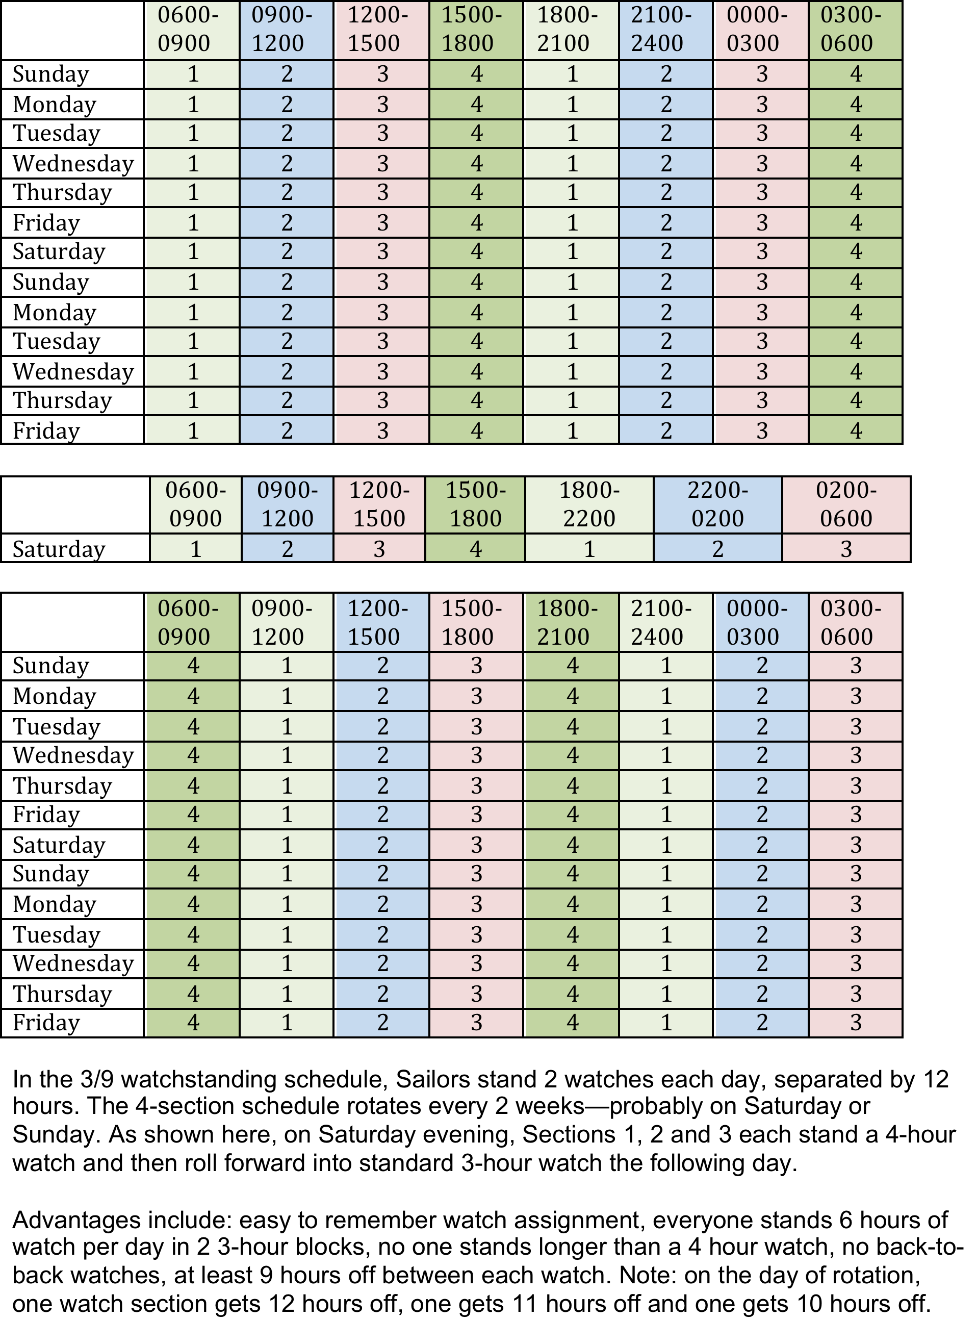
NOW 3/9 Schedule
3/9 watch shifts forward every other Sunday
All watchstanders are up between 0900 and 1500 for working hours
All watchstanders receive 7 hours of sleep each night
No watchstanders stand consecutive back to back watches; never more than 4 hours watch at a time; avoids heat stress

Slide 59
Cc
Cultural Norm of Sleep Deprivation
Deployment to Combat Zone
Sleep
Deprivation
Poor sleep
practices
Trauma
Epidemic of insomnia
Persistence of poor sleep practices
Overlap of sleep disorders, PTSD and TBI
Source: Vincent Mysliwiec, MD, LTC MC USA

